Slide 1
Sustainable Marketing
2016 Trends- Upcoming Trends and How to Spot Them
Data contributed from Rose Wilson, Rosalie J Wilson Business Development Services and Mary Peabody, UVM Extension

Slide 2
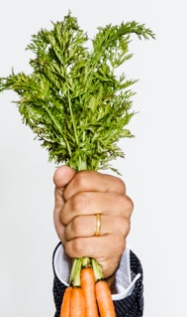
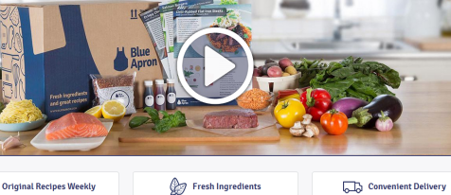
Macro Trends & Key Words
Healthy & Natural
  Functional Foods
  “No additives, no... no …”
  “Whole”; “Wholesome”
  “Natural”
  “Hand” (made)
  Beige & green toned packaging
Personalized
Ethnic
Waste Conscious
  Eat your Root Greens
  Eco-packaging
Convenience
  “Easy”
  “Simple”
  “5-ingredient”
  “Quick”
  “To-Go”
  “30-minute Solution”
  Delivered/Delivery Service
  Pre-packaged
  Pre-prepared
  Meal kits
Photo: Alex Lau
www.blueapron.com
Notes:
Healthy Food
Millenials – benefit: active lifestyles
Baby boomers – benefit: longevity, quality of life
Convenience & Personalized Service
Prepared foods, meal kits, delivery service
benefit: multi-task (eat on the run), more snacking/fewer sit down meals, less time food prep, few millenials know how to cook
Ethnic cuisine
eating for pleasure, as an experience
growing ethnic populations bringing cuisine with them in a time of global access to ingredients
Waste conscious: trending now is eating root greens (carrot greens, kohlrabi greens in addition to beet greens). Consumers are more waste conscious (albeit the Keurig movement!)

Slide 3
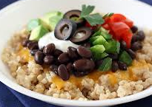
2016 Consumer Trends…
Oatmeal- sweet and savory
Grass-fed meats
Upscale non-alcoholic beverages
Vegetables and Fruit forward
Ancient grains- Amaranth
Savory oatmeal Tastespotting.com

Slide 4
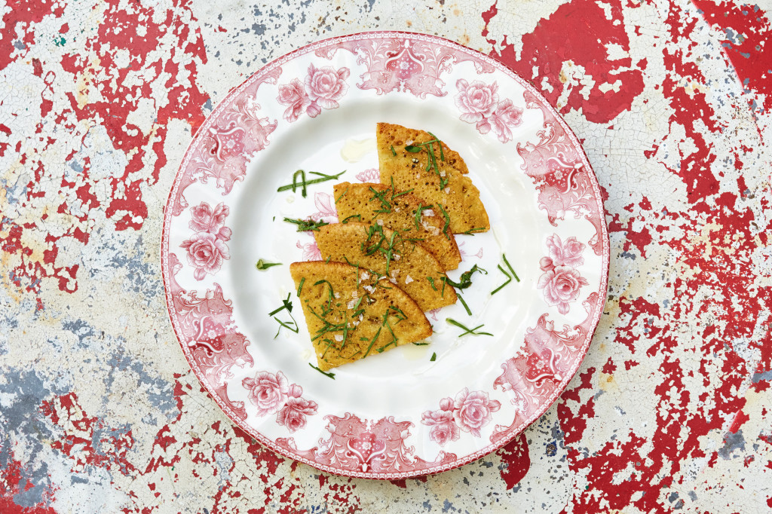
2016 Consumer Trends…
Pulses- high fiber, plant proteins
Alternative flours (GF)
Flavorful herb mixes- thyme, rosemary, lavender
Seaweeds
Fermented Foods
Chickpea flour, rosemary, and fennel seed socca with parsley at Terrine in L.A. Photo: Ryan Tanaka
Notes:
Pulses- high fiber, plant proteins
Flavorful herb mixes including rosemary
Alternative flours (GF)
This photo is hitting on at least three of these trends!

Slide 5
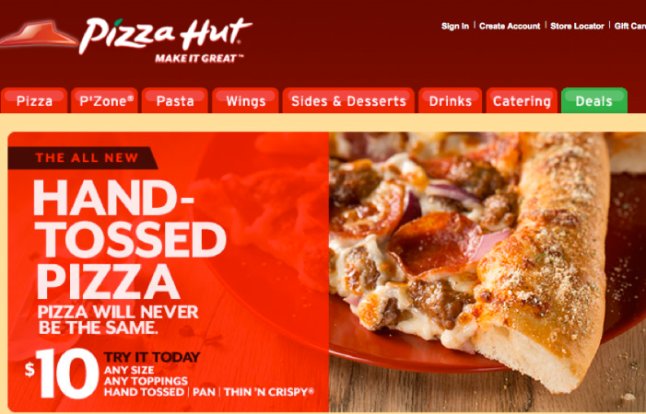
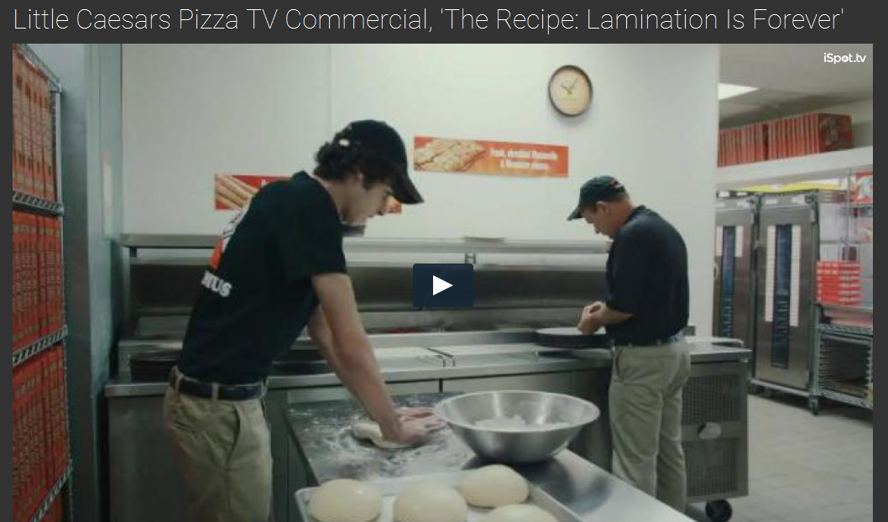
2016 Consumer Trends…
Full Fat is good
Sugar is bad
Fried Chicken
Whole, Natural Foods – not processed
Raising the heat levels
Pizzahut.com
http://www.ispot.tv/ad/AZX9/little-caesars-pizza-the-recipe-lamination-is-forever
Notes:
Whole Foods- again reinforcing the “No additives, no... no …”
all natural, made by hand… Even Pizza Hut, Domino and Little Ceasar’s are trying to get away from being considered processed, advertising that their dough is “made by hand”
In the Little Ceasar’s ad above, A Little Caesar's employee is making dough for pizza when he asks his supervisor why haven't they changed the process for making dough. He mentions that Little Caesar's has been making dough from scratch, by hand for over fifty years. His supervisor looks at him and tells him it's because the recipe is laminated. He hands a laminated sheet of paper to the young employee with the dough recipe which reads, "Make it by hand from scratch every day." When the young employee asks if this can ever change, the supervisor looks at him and tells him that it's forever, because it's laminated.- a cheeky way of trying to acknowledge they are automated, but still trying to relate to being genuine and wholesome and thus handmade (even though the batch size of their “handmade” is certainly something to wonder about!)…

Slide 6
What’s Hot in Snacks
Shift from sweet to savory
Combining sweet with heat
Shift from high-carb to nutrient dense
Notes:
Vegetables and Fruit forward
Pulses- high fiber, plant proteins
Seaweeds
Fermented Foods
Alternative flours (GF)

Slide 7
Look for new products…
Spicy-salty-savory ethnic snacks are afternoon favorites and meal replacements…
Hummus variations
Chili-citrus potato chips
Mango-chili-lime chips
Flavored popcorns (like seaweed and sesame)

Slide 8

What consumers will be looking for…
Jerky
Hummus
Popcorn
Crazy chip flavors
Spicy-salty-savory mixes
Ethnic snacks (Japanese and Korean)
Spiralized veggies
Brussel sprouts are the new kale
Cauliflower (steaks, mashed “potatoes”, “rice”…)
Farro is the new quinoa
Savory yogurts
Primalpalette.com
Notes:
Jerky, hummus- support the move from high carb to protein/nutrient rich trend

Slide 9
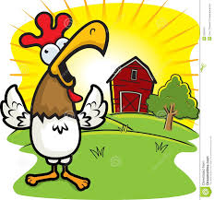

Rising
Setting
African flavors
Authentic ethnic cuisine
Artisan soft drinks
Middle Eastern flavors
Pop-up restaurants
Hyper-local sourcing
House-made ice cream
Artisan butchery
House-made/Artisan pickles
Nontraditional eggs
Underutilized fish
Kale salads
Fresh beans/Peas
Gluten free
Quinoa
Dark greens
Coconut water
Asian noodles
Flatbreads
Egg-white
Lo-Cal entrees
Alternative sweeteners
Hybrid desserts
Notes:
Fresh beans/peas- cuz high carb?
See the egg article in Better Homes and Gardens
See the bon appetit trends- setting sun on flavored waters

Slide 10
How to Spot Trends
Survey & listen to your customers: What are they talking about? What are they asking for? How are their lives changing?
Read food magazines
Watch the Food Network and cooking shows
Look for innovation in the Grocery Store
  ones that tend to lead on trends: Wegman’s, City Market
  What products are drawing consumer attention? What are people buying?
Sign up for Mary’s annual trends webinar! Mary.peabody@uvm.edu
Search the internet
  Food Associations- National Retailers Ass’n, National Restaurant Ass’n
  http://www.baumwhiteman.com/2016Trends.pdf
  http://www.bonappetit.com/trends/article/food-trends-2016
Notes:
Purchased third party data such as mintel and spins
For eg. Ask your customers if they are into “spiralizing veggies”- have they even heard about it? Would they want you to grow veggies to a size to accommodate their spiralizing? You can make it fun and engaging when you ask topical questions, it gives you a reason to communicate, which reinforces customer relationship and it provides valuable insight on how to better serve your customer which ultimately these three things- cultivating a relationship, optimal customer service- providing what they need and want lead to = customer retention, which is what YOU want.

Slide 11
What to do with the Data?
Look for commonalities
  Three magazines with a falafel recipe…
  5 advertisements using beige and green packaging to promote “natural” “wholesome” offerings…
Look at how you can apply trending ideas, words, packaging and presentation to your business, products and services

