Slide 1

MARKETING 201: Helping Farmers Stay Competitive in a Maturing Market
Notes:
As the local foods market matures and competition increases, it’s becoming harder for experienced farmers to maintain market share and new farmers to break in.
Here are some tools and techniques to help farmers adapt to market trends, differentiate themselves, and stay relevant.

Slide 2
Agenda
What is a Maturing Market?
How to Survive in a Mature Market
Using Online Marketing as a tool
Q&A

Slide 3
As one farmer put it
“20 years ago, mediocre stuff sold. Quality is now very important. [Our] Sales have slumped due to quality issues. There is just too much competition and much of it is better quality.”
4/27/2017

Slide 4
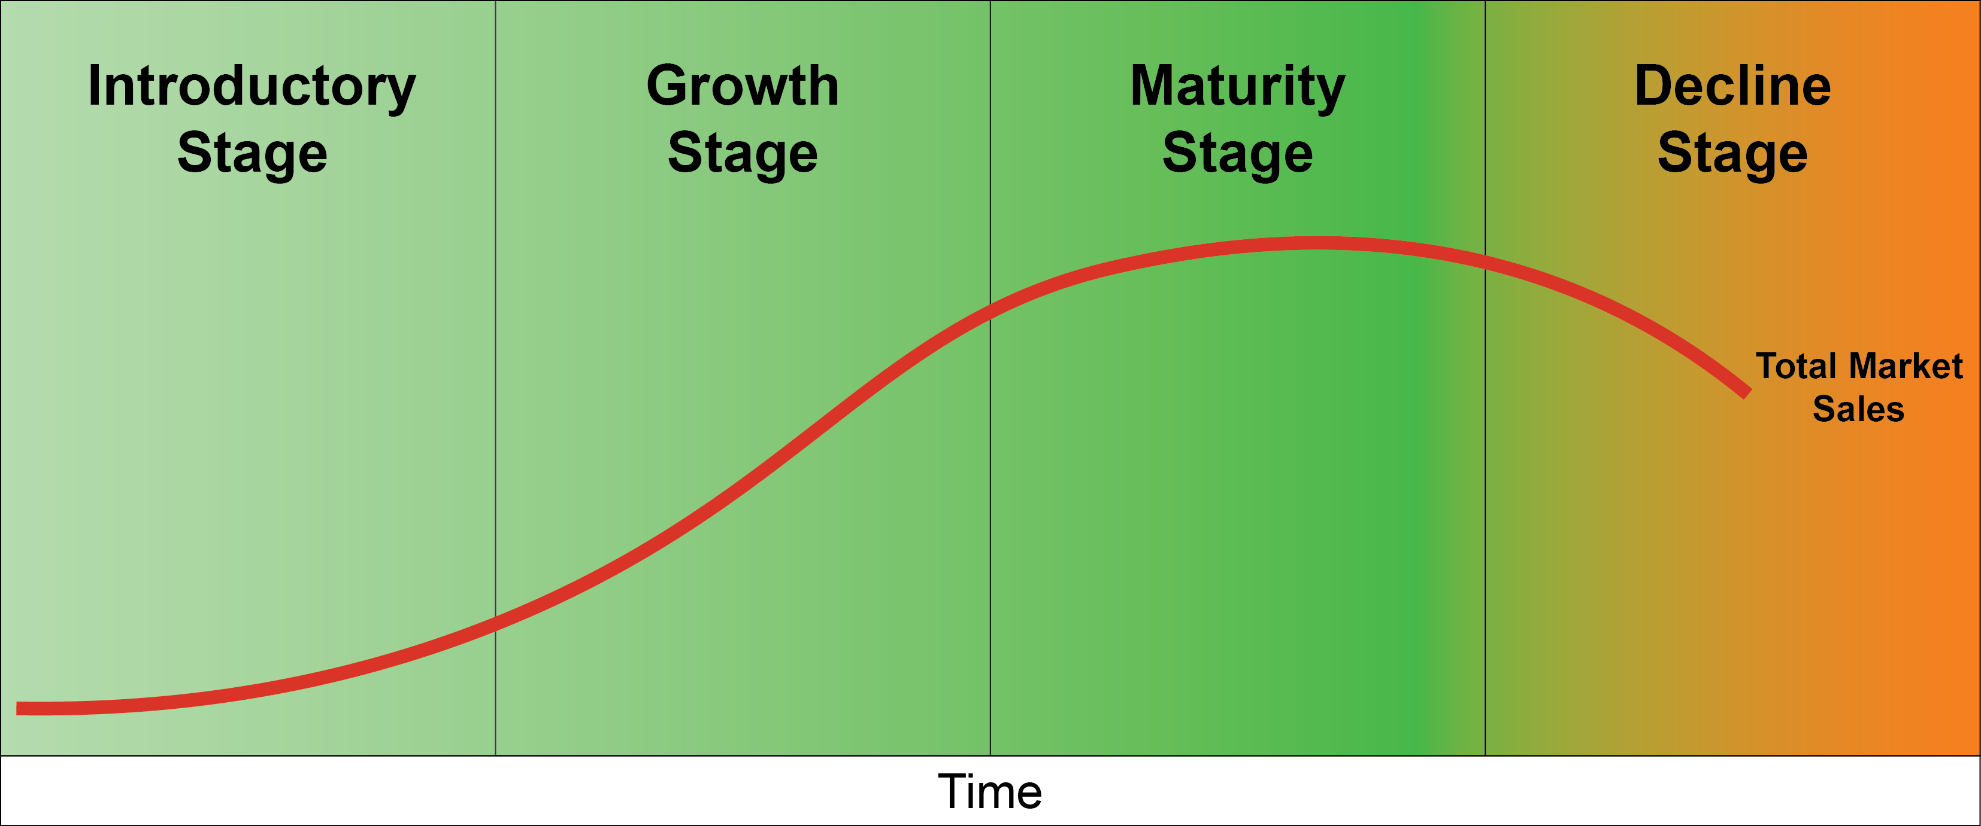
The Local Foods Market Is Maturing
Notes:
In a mature market, the overall market may still be growing, but your growth may be compromised as increasing competition absorbs the growth in demand.
Characteristics of a Maturing Market
Rate of growth slows
Rate of competition increases
Level of quality, professionalism, big brands and innovators jumping in all go up
Price wars begin, premiums decrease
Maintaining market share and customers requires increasing effort

Slide 5
Surviving in a Mature Market
Understand your customer
Use market segmentation
Innovate if necessary: new products, services, availability
Keep your brand fresh
Be able to withstand price pressure
Provide a great customer experience
Focus on increasing communication and visibility
Notes:
When a product life cycle gets to a Maturing Market stage, it can make or break you. Marketing is particularly critical at this time, because of the increased competition.
The companies that will survive in a mature market must:
Understand their customers
Use market segmentation
Be able to innovate if necessary: new products, services, distribution channels
Have a strong brand
Be able to withstand price pressure
Provide a great customer experience
Focus on increasing communication and visibility

Slide 6
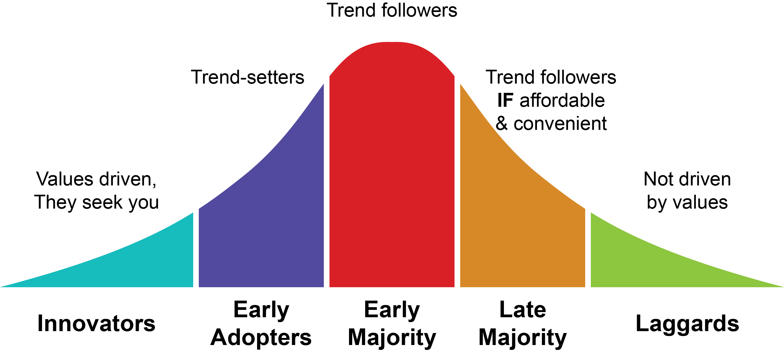
Customers Change as the Market Matures
Notes:
As the market matures, the target market is evolving from early adopters who were more committed to a broader but less committed audience
Newer consumers may want to participate, but because they tend to be less committed to core values, price and convenience will be higher decision-making factors.
The chart illustrates a typical new product adoption curve
Innovators: First people to join a CSA
Early Adopters: Farmers market regulars
Early Majority: Whole Foods, Co-op shoppers
Late Majority: Walmart, Supermarket shoppers (even Walmart markets local and organic now)
Laggards: Not driven by values, will not seek out local food

Slide 7
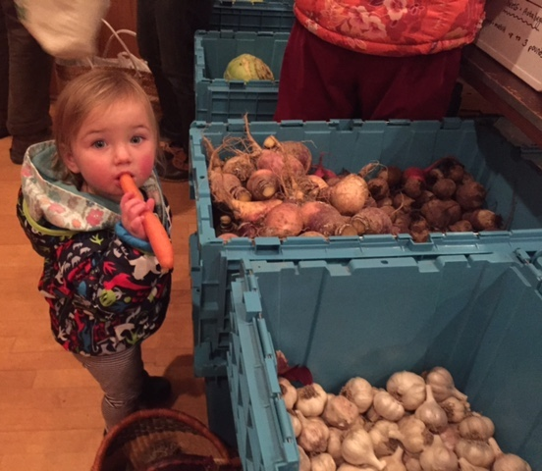
Who Are or COULD BE Your Target Customers?
Early adopters… mainstream
Local… national
Millennials AND baby boomers?
How can your product appeal to a broader consumer base?
What are their needs & values?
How do you reach & resonate with them?
Feast & Field Market, photo credit Chloe
Notes:
As the market matures, there are good benefits: more customers… mainstream acceptance of your products, yay, right? Finally, you made it!
But, just when you think you are there, you notice something doesn’t seem right, you should be getting more customers, not less, why does it feel like your sales and markets are on the decline? When your grass looks green someone will start eyeing your field. It is not a mistake, you have demonstrated there is an opportunity to be had, other people want to horn in.
This is a key time to undergo renewed market research and an updating of your target market. Who are your customers NOW, and who else could BE your customers?
The “total addressable market” has expanded beyond the early adopters. Those folks were easy picking--hard core believers who went out of their way to buy your product and pay a premium. As the market matures, new customers will expect you to come to them, they have plenty of providers to choose from and they know it, these folks need to be won over.
So, you need to learn about them…
Who could use your product or service? Make a list of all the different types of people (mom, athletes, families, single folks, sports fans, millennials, baby boomers, ethnicities, income levels, personal interests- avid readers, animal lovers, nature enthusiasts?, etc.).
Describe the characteristics of each audience. Each will have different needs, habits, expectations, motivations, interests, values, and methods of communication.
You need to research what is important to them, how to package, price and get it in front of them, and how to communicate with them so your message can be heard, absorbed and acted upon.
Methods of communication--where do they shop, how do they absorb information, where do they learn about new products/services--do they read newspapers/magazines, listen to the radio, watch TV, use the web, text, e-mail, social media? If social media, which channels--Facebook for baby boomers, Instagram for millennials? And which times of day?
As your market matures, your original target market will morph into a larger living and ever-changing community. Your message will be tuned out if you don’t have the ability to look at this larger community and realize that within it are many little communities, each trying to be heard and represented.
Marketing from here on out will take more time and money. Profit margins may be slimmer, as you may need to innovate more frequently and customize packaging, delivery and messages for more and more audiences.
If you can do this though, you’ll succeed. While per unit margins may go down, the volume of units may go up, or profits from new services or products offset lower profits from mature products. So, all in all, you can continue to grow or stabilize your bottom line--it just takes more work. (The golden age of being one of a few limited entrants in a field serving eager early adopters is gone!)

Slide 8
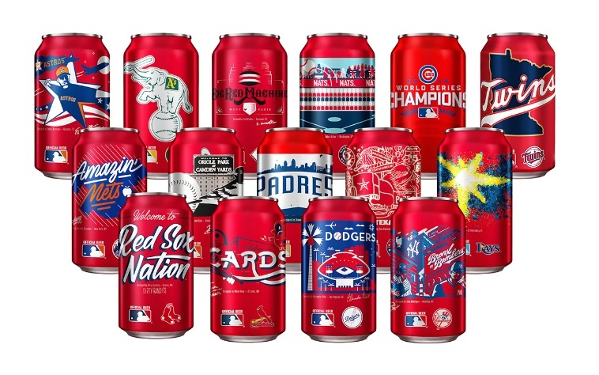
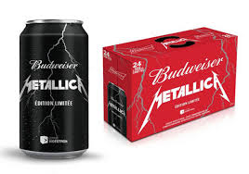
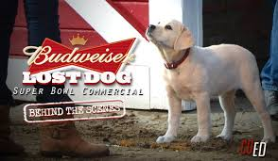
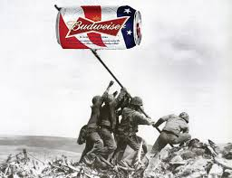
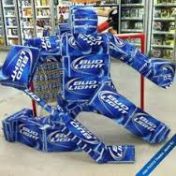
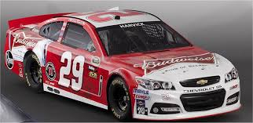
Increasing Market Segmentation
Budweiser Canada (via Le Journal de Quebec)
https://www.brewbound.com
https://www.thedriversuitblog.com
https://www.dumbuzzfeed.wordpress.com
https://www.pinterest.com/waynewhelan/displays/
Notes:
So how do we do this? Segmenting your market is key.
As I explained, the more competition you have, and the more people your product COULD appeal to, the more on point your message needs to be. It needs to resonate with each audience and be seen and heard above your competition.
And remember, market segmentation doesn’t have to be expensive. For example, a Budweiser sales rep came up with a unique beer display aimed at hockey fans. It cost the company nothing to create, but it certainly gets its message across.
Think of how you can connect and align with a broader audience, and how you can personalize your message. For example, in February, Jasper Hill (an artisanal cheese maker) titled its e-newsletter “We've Got Game Time Snacks Covered!” who do you think they were marketing to? (Superbowl fans, mainstream America… not the typical high end cheese audience), why do you think they are trying to appeal to football fans?
In the “good ole’ days,” Jasper Hill wouldn’t have needed to appeal to a football audience, but as you can see, even brands we think of as successful, brands who seem to have “made it” feel a need to be looking around the corner and staying one step ahead.

Slide 9

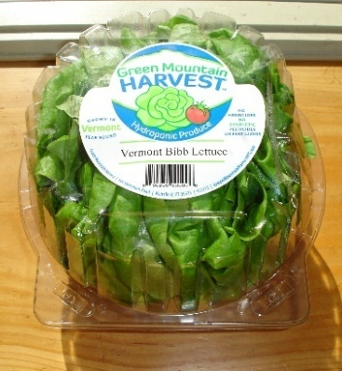
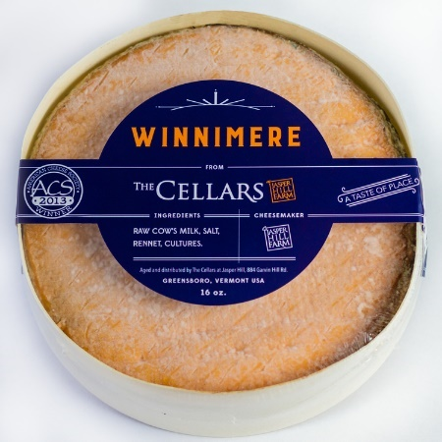
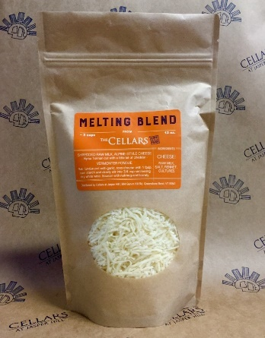
Do You Need to Innovate?
Original product…new year-round, clean offering
Production Methods
Value Added
Availability
Delivery
Distribution
Photo credit: Dave Hartshorn
Photo credit: Rose Wilson
Original product…new convenience offering
Notes:
A key way to reach new audiences and remain relevant to existing ones is to innovate- refresh, expand, or evolve product offerings or services….
Innovation can mean inventing something new but it doesn’t have to--it can simply mean producing, packaging or serving your product or your audience differently than before facilitating your ability to retain or grab their attention.
Conduct a Product Review
What is your product? Where does it fall short in meeting the needs of market segments you identified as prospective customers? How could you address this? What would it cost? Is it feasible?
For example, Dave Hartshorn, of Harthshorn Organic Farm, felt he had to make a difference to stay competitive and mitigate against increasing climate risk. Now, he not only continues to farm his regular, field-grown certified organic lettuce, he also produces a hydroponic lettuce, opening his access to year-round markets and to chefs who wanted a “clean” lettuce while alleviating financial risk from outdoor crop loss….
Looking at Jasper Hill again, here is another example of their strategy to penetrate a more mainstream audience. In addition to football marketing messages, they have now created a product perfectly positioned for this audience. The cheese didn’t change, but it now comes in a pre-selected cooking blend, pre-shredded, and sold in a resealable Ziplock bag. In their marketing messaging, they compare it to commodity shredded cheese. Who are they appealing to? And what changed? The cheese is the same but they added convenience factors, toned the message, and presented the cheese as an ingredient for everyday cooking.
Farmers 2 You began a home delivery CSA when they identified a gap in service needs for metro Boston dwellers. Residents wanted access to local food, but needed the convenience of home delivery.
Meal kits evolved as a competing strategy for solving that same need… so, how are your products meeting/not meeting your current and potential markets’ needs? What can you do about it? What is the cost benefit to do it? What are the downsides if you don’t?

Slide 10
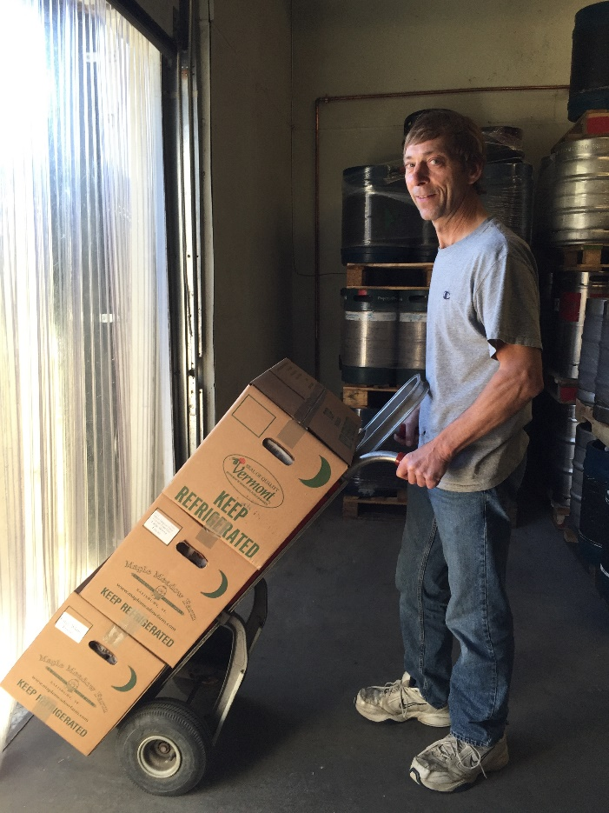
New Distribution Channels?
Direct
Partnerships/Coops/ Aggregation
Wholesale
Institutions
Distributors
Shippers
Photo credit: Farm Connex
Notes:
In order to maintain or expand market share, you may need to branch out into multiple modes of distribution and delivery.
As appeal broadens, access and modes of delivery also tend to become more mainstream. Many of your new prospects won’t necessarily be looking for you; you may need to go out of your way to get your product to them.
Again, this takes more time, more energy, and potentially more money. As we said, it will trim the margins, but will either enable you to maintain or grow market share and thus ideally maintain or grow net income over the long run (as margins per unit decrease but number of units sold increases).
Here’s where market research comes in again. These questions trigger a host of business planning implications:
What are the costs of each potential sales channel/method of delivery/distribution?
What are the price points you need to remain relevant to the target audience for each?
What scale do you need to be for this amount of cash flow?
How feasible and desirable is it to grow to this scale?
If you don’t do it, what will happen?
If you do do it, what else may be needed? For example, just because you decide you need distribution doesn’t mean a distributor will take you on. You need to research what their requirements are and how to pitch yourself to them, as well as to the end user (liability insurance, demonstrated market share, etc.).

Slide 11
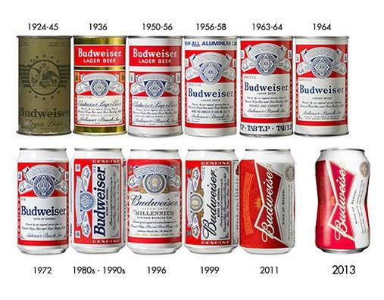
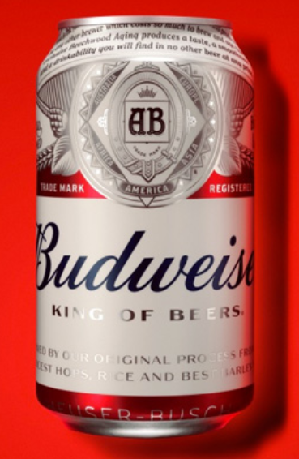
Big Brands Stay Fresh
2016
http://www.plzdontletbuddie.com
http://www.adweek.com
Notes:
Rebranding helps brands stay relevant. Updating your brand is not a bad thing. It helps you:
Stay visible and fresh to the consumer.
Have something to talk about when there’s nothing new to report. You always need a reason to communicate.
Big brands have learned that when there’s nothing new to communicate, might as well update the packaging or tweak the product a wee bit--“new look, same great taste!”; “new and improved!”
Brands often undergo a revitalization when markets mature or when they feel their market share slipping.
Does your brand need a new look?
Now is the time to invest in a “new look,” consider updating your logo, tagline, packaging and marketing materials
Plan to include a budget for branding updates, expect to update every few years and more frequently as needed, and expect this to become a standard, routine part of your marketing strategy as your market matures.

Slide 12
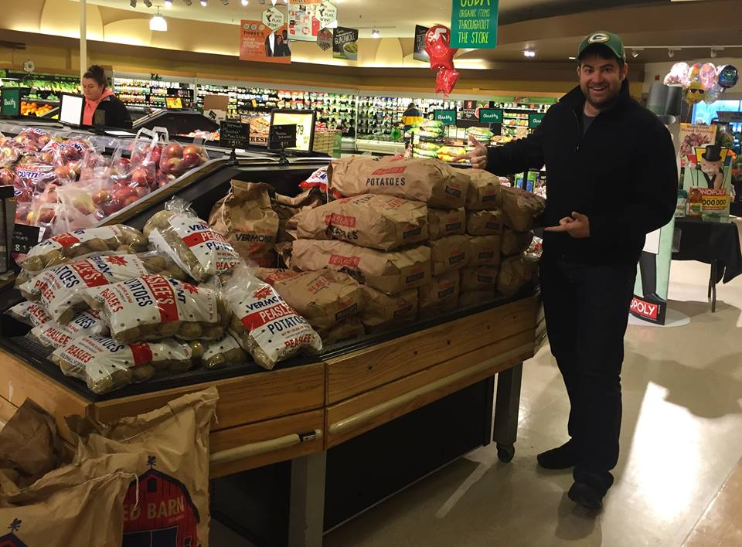
Brand Value
Be able to withstand price pressure
Photo credit: Peaslee's Vermont Potatoes
Notes:
As the market matures, your market audience broadens into mainstream consumers. With mainstream consumers convenience and affordability matter.
Product price elasticity may diminish. This could create either a hurdle or an opportunity for you:
Can you increase volume and go down in price?
Can you maintain your current volume at your current price?
What’s your strategy to deal with increasing price pressure?
Can you offer deals, sales, incentives?
Can you cultivate brand loyalty in your existing customer base such that they withstand the charms of convenience and price and still choose you?
What happens if your customer base does erode? Develop a contingency plan so you are prepared. If you can’t work on price, you NEED to work on maximizing communication and considering how to maintain customer loyalty, what feature/benefits make you unique?

Slide 13
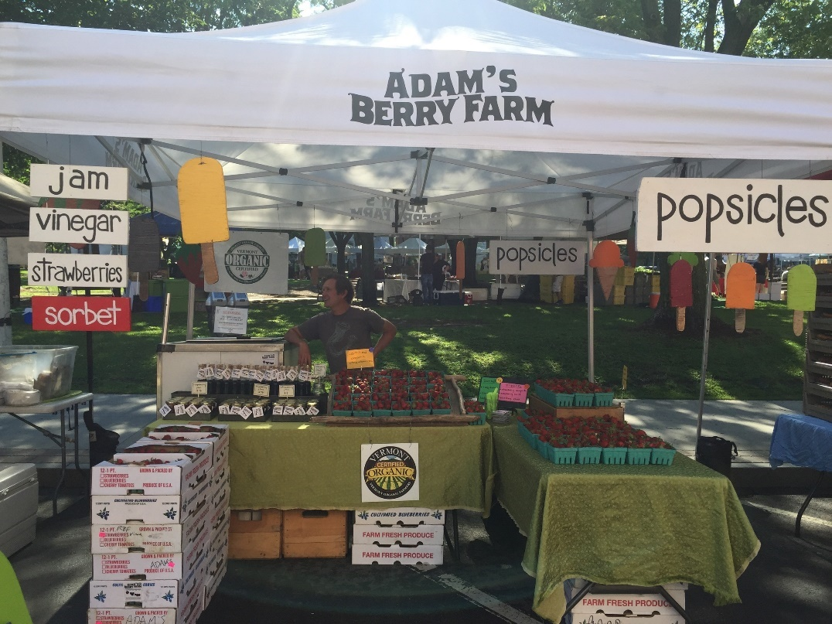
Provide a Great Customer Experience
Outstanding quality & service
Trustworthy & reliable
Personal interactions
Friendly
Product info
Authenticity & transparency
Photo credit: Adam’s Berry Farm
Notes:
As the market matures and there are more competitors (i.e. more choice), the product begins to matter less and the customer service begins to matter more…
Evaluate your customer service. How could you be doing a better job?
Product: needs to communicate its value- is it a lower cost lower quality entrant or a truly outstanding product with a premium price; it can be either, it just needs to be properly communicated.
Brand: People need to know what you stand for, quality or price or customer service, what is your angle? They will make a selection on what to buy/where/who to purchase from based on what feature/benefit matters most to them. If you are aiming to be anything other than a low cost entry, your quality and brand reputation need to be trustworthy and reliable.
Personalization matters: the customer needs to feel you’re speaking to their needs and interests (market segmentation messaging, product and service innovation), and they need to interact with you on a personal level (direct sales, in-store demos, underwriting/sponsoring of their interests (local ball team, public radio, humane society, etc.). Sincerity matters.
Attitude and Demeanor matter: All staff and answering tools (automated v-mail, e-mail, etc.) need to be crafted in a friendly and helpful manner & tone of voice. Train staff on telephone and customer interaction protocols.
Packaging and point of sale need to provide price, product & usage information--people read labels! People want to know what things cost!
Be authentic and transparent.

Slide 14
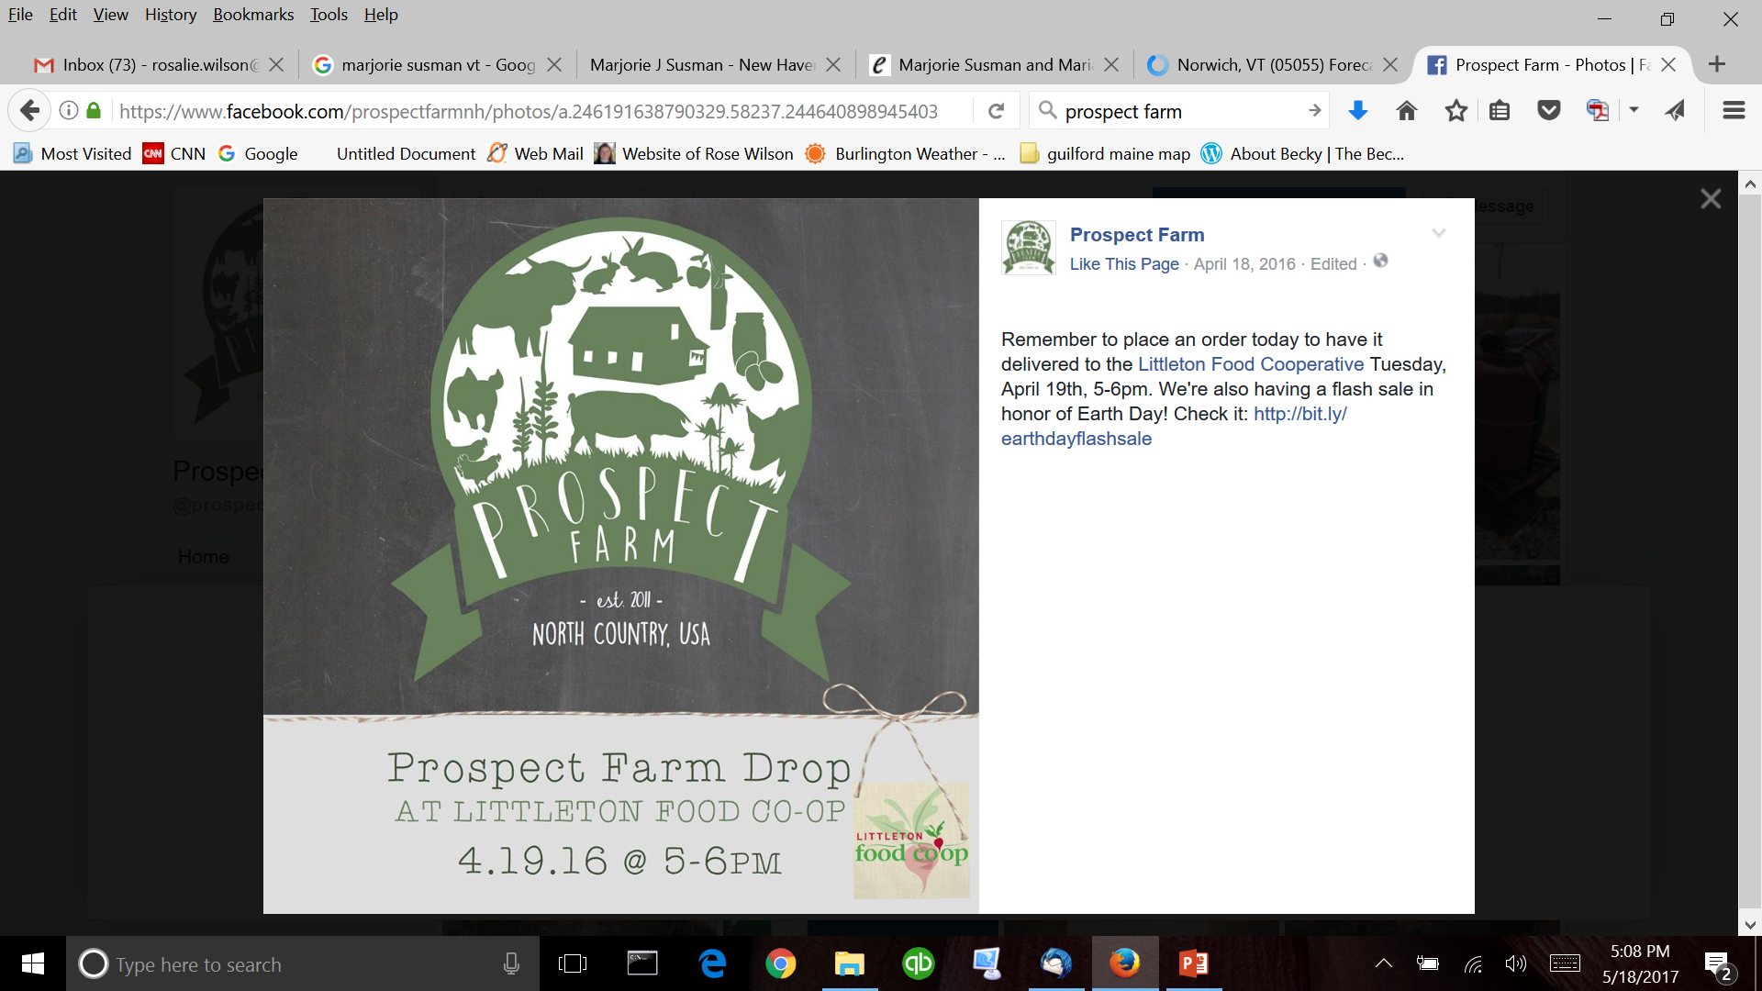
Communication & Visibility
Unique strengths
Features & benefits
Differentiation
Consistency & repetition
Screenshot credit: Prospect Farm
Notes:
When brands face increasing competition and consumers face more choices, you need to be better than ever at communicating your unique strengths, features and benefits, and how they are relevant to each audience and then you need to repeat to reinforce this message.
Maintaining mind share is key.
Find reasons to communicate with your customers, and keep doing it (again, this is where updating your brand every few years becomes a marketing tactic).
Even if you’re small and feel silly or don’t feel you have anything to say, remember that you’re a tiny fraction of your customers’ day-to-day thoughts, if that, and they appreciate and need you to remind them you exist.
And remember, if they don’t want to receive your messages, they’ll opt out or tune you out. And if that is the case, then they weren’t your customer anyway and you need to move on.
You have to think of this repetition and more frequent communication as a useful service to your customer. I get e-mails from Bath and Body works up to 3 times a day. I shop there maybe 2x per year! But, when I do shop, I appreciate the coupons they send in the e-mails and so I let it bombard my e-mail… Again, it is not pissing me off so much as me accepting that I get a bit of clutter, but that clutter does actually lead to me sometimes spontaneously ordering something…
Using Jasper Hill again, they send out an e-mail every two weeks, whether or not they have something “noteworthy” to report. Recent e-mail headers included:
French Expertise, Vermont Terrior (Note: they even sent it with a spelling error, the important thing is to send it!)
Newsletter from the Cellars at Jasper Hill
Stay on the nice list: help out our neighbor in need.
Shredded cheese? Let us get that for you.
We've Got Game Time Snacks Covered!
Three Cow Creamery, who literally has three cows, started sending out an e-mail prior to her weekly appearance at farmers markets, just reminding people to come and telling folks what happened that week or month on the farm. If I have time to read it, great, if not, it hasn’t annoyed me to get it, and it does remind me not only to buy her products but that the market is happening in general. Thus, it’s a USEFUL service and I appreciate getting it.
Think about what your current frequency of communication is and how you can augment both the frequency of the message and customize the content to better resonate with each of your increasingly segmented target markets.
In this example, I chose Prospect Farm, a fairly small meat CSA in Northern NH, because they do a great job of frequent communication, using all sorts of neat ideas for reasons to communicate, such as an Earth Day flash sale! and general reminders about CSA pick ups. ** Note: remember the goal is not whether people took you up on the sale but that the sale gave you a reason to communicate. Don’t feel discouraged if people don’t take you up on the sale, a) no one but you knows that and b) the larger goal was to have a reason to say something, if you get a sale out of it even better!

Slide 15
Using Online Marketing in a Competitive Environment
Notes:
Digital marketing changes all the time.
While some opportunities, like free promotion on Facebook, are much harder to take advantage of than they used to be, other changes, such as Google’s efforts to make local businesses show up in search engine results, can help small local businesses (at least for now).
In today’s competitive environment, every business needs to have a digital presence of some kind, but the type of presence you need depends on your business and customers.
Farm viability professionals should be conversant in the trends.
You don’t have to know all the technical details, but you should understand the basics, so you can provide some big picture advice.

Slide 16




Learn About Your Customers
Google Analytics
Email open & click rates
Facebook & other social analytics
POS analytics
Notes:
Almost every application offers some type of analytics. There’s a lot of useful information you can use to build a portrait of your existing customers.
Available info may include demographics, customer behavior on your website or channel, interests and hobbies, device, frequency of visits, last visit, purchase behavior, etc.

Slide 17


Use Google Analytics & Search Console
Visitor demographics
Visitor affinity categories
What search terms visitors are using to find you
What’s driving your traffic?
Most popular pages
Time spent on site
Notes:
Google Analytics and Google Search Console are free tools to help you understand and improve your website.
They can take some time to learn, but there are lots of free videos and guides to learn it.
https://analytics.google.com/analytics/academy/course/6
https://www.quicksprout.com/2016/06/15/the-ultimate-guide-to-using-google-search-console-as-a-powerful-seo-tool/
Use Google Analytics and Google Search Console to understand:
Where’s your traffic coming from?
Is social media driving traffic to your site?
Which pages are most popular?
How long are visitors staying on your site?
Who are your visitors: Age, gender, locations, interests, industries?
Notes: Some of this information only shows up if Demographics and Interest Reports are enabled in Google Analytics.
To enable Demographics and Interest Reports: https://support.google.com/analytics/answer/2819948

Slide 18
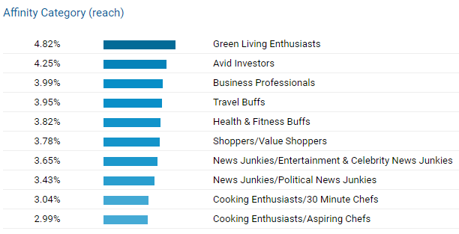
Google Affinity Categories
Top categories for Good Egg: Green Living Enthusiasts & Avid Investors
Notes:
Report from Google Analytics for Good Egg Marketing
You can find your website visitors’ interests and their industries under Google Reports/Interests/Affinity Categories

Slide 19



Get Found With SEO
Notes:
SEO is Search Engine Optimization, a set of tactics to help your business show up when someone searches for them on the web.
While SEO can be complex, the basic tactics are easy to learn and can have a huge impact on whether your website shows up on page one of search results.
Google and other search engines want to help users find the most relevant results possible.
Your goal is to determine the words that users are most likely to use when searching for your product or service. Those are the “keywords” you should use should use for the page.
Each page of your website should be built around a unique keyword or phrase.
Many tools, including Google Search Console, can tell you what keywords people entered when they were searching and ended up at your website.
If possible, identify 1-2 secondary keywords with a similar meaning as the primary keyword, but say it in another way.
For example, you can use “pick-your-own apples” as your primary keyword, and “apple-picking” as a secondary keyword.
You should try to use your keywords in your headlines, first paragraph, subheads, captions, and throughout the page.
Keywords should be used in a natural-sounding way and only when they are relevant to that page on your website. If you try to use or repeat the words in a forced or unnatural way, you’ll sound foolish. In addition, the search engines might penalize you for “keyword stuffing.”
If a page on your site is about more than one main topic, split the content into separate pages, so that each can focus on a single main topic with a unique keyword.
Longer phrases are sometimes more effective than 1 or 2 keywords. For example, some people will search for a simple keyword (e.g. “apple-picking”), whereas others will use a longer phrase (e.g. “where can I go apple-picking”). These 3-4 word long phrases are known as “long tail keywords.” Long tail keyword phrases can be very effective at helping your site get found.
As more people use voice to search on their devices, they are tending to ask questions, rather than use a few keywords. For example, someone might say, “Siri, where can I go apple-picking near me?” Try to anticipate the types of questions that people might ask about your business and include the questions and answers in your content or on a FAQ page.

Slide 20
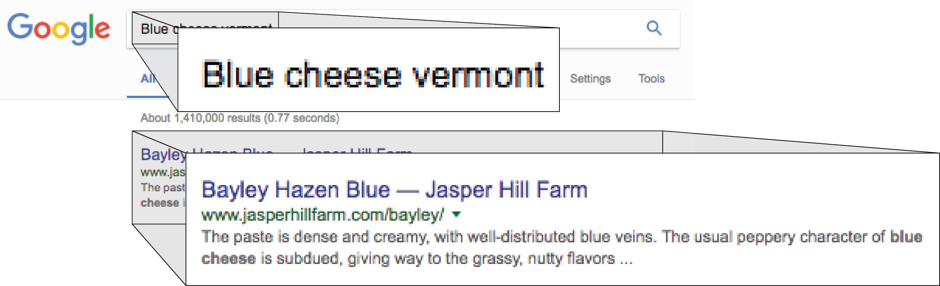
Page Titles & Descriptions
User enters a search term such as “blue cheese vermont” into Google.
Page Title
Page Description
Notes:
Page Title
The Page Title is also known as the “Title tag.” This is the first line that shows up in your Google search results.
The purpose of the title is to provide information about what is contained on that page.
The page title does not have to be the same as the headline that appears on that page.
Each page title should be a little different, because the content of each page on your site is different.
Your title tag will also appear at the top of your web browser when that page is open.
Some social media sites, like Facebook, also display your title tag when you insert a link to that page into a post.
How to Set Up a Page Title
The technical term for a page title is a “title tag.”
Most web building software gives you a place to enter a page title in plain English, and the software adds the code.
Google allows you to include 50-60 characters in your title. (The exact number varies because some typefaces are wider than others.) If your title is longer than that, the additional characters will be cut off.
Tests show that people pay most attention to the first few words, so it’s usually best to put the information about what’s on the page at the beginning of the title, followed by a little more info, followed by your business name/brand name. Also, sometimes even shorter titles get cut off, so make sure to put the good stuff first.
The first part of your page title should ideally be your primary keyword, followed by your secondary keyword. You may also want to include your location (city or neighborhood, and sometimes the two letter state abbreviation), especially if you want to attract local business.
Your business or brand name should be included on your home page, contact page, about page, or other pages specifically talking about who you are, but it doesn’t need to be in the page title for every page. If you do want to include it on every page, it should usually go at the end of the title.
If you’re linking several unrelated pieces of information together, it’s usually helpful to separate parts of the title with a bit of punctuation, such as a hyphen ( - ), colon (:), or a pipe ( | ).
Page Description (also known as a metadescription)
The technical term for the page description is the “metadescription.”
Most web building software gives you a place to enter a page title in plain English, and the software adds the code.
The page description shows up as the third line in your search engine results (below the URL).
Your description should be a concise, compelling summary of what that page of your site is about.
Every page on your site should have a unique description.
Text doesn’t have to be in complete sentences. You can list prices, sizes, colors, brands, and other information that’s relevant to what your page is about.
Google will bold the user’s search terms if they appear in your description.
Try to keep the description to less than 160 characters. Google will cut your description off if it exceeds that. (The exact number of characters that will fit varies depending on the width of the typeface you’re using.).
Include your primary keyword and any other relevant keywords.
If possible, also make sure that your images have titles and “alt text” describing them, incorporating your keywords and location, if possible.
https://yoast.com/image-seo-alt-tag-and-title-tag-optimization/

Slide 21

Think “Mobile First”
Flexbox, Creative Commons
Notes:
Nearly 60% of online searches are now on mobile devices, including cell phones and tablets
Google penalizes website that aren’t mobile-friendly.
Your site must be responsive (adjust to look good on desktops, tablets, and phones) and load quickly.
Free test to see if your site is mobile-friendly: https://www.google.com/webmasters/tools/mobile-friendly/
If your site loads slowly, you’ll lose visitors.
Free test to see how fast your pages load: https://developers.google.com/speed/pagespeed/insights/
If you have a retail business, make sure your phone number, address and hours are prominent. Ideal to have it on every page.

Slide 22
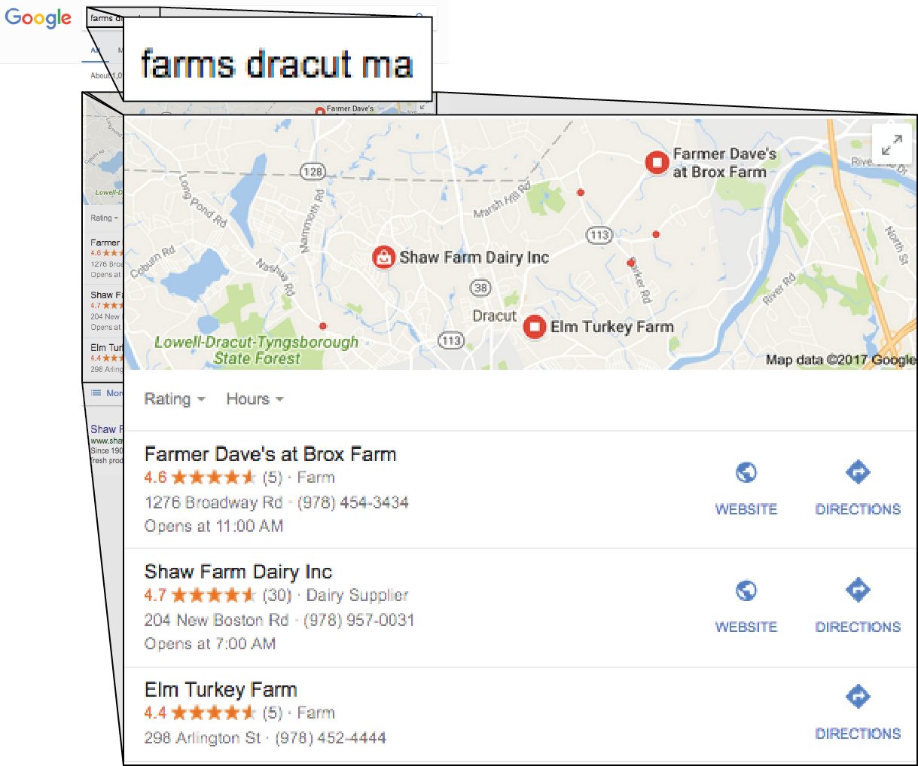
Google’s Local 3-Pack
User searches for “farms dracut ma”
Google’s “Local 3-Pack” showcases the 3 farms in Dracut that it has assessed as the most relevant.
Notes:
Google now features this type of “Local 3-Pack” on almost every search for a local business, such as “farms near me” or “farms [neighborhood or city].
Using SEO techniques, especially having a mobile-friendly website that uses local keywords can improve your chances, but Google’s secret algorithms determine whether you make it into this top 3.

Slide 23
Increase Visibility & Communications
Increase visibility using online marketing.
Choose a few online channels to start.
Each marketing channel helps reinforce the others.
Don’t ignore conventional marketing!
Notes:
Online marketing can help your business increase visibility.
Choose a few online platforms to start. Don’t try to be on all the platforms at once.
Being on one marketing channel helps increase your visibility on other channels. For example, a strong social media presence can help your SEO.
Don’t ignore all the conventional off-line marketing techniques, like postcards, signage, and ads.

Slide 24








Claim Your Business Listings
pickyourown.farm
Notes:
Search engines reward sites with other sites that links to them.
Having a listing on business directories and review sites helps people find your business.
There are thousands of business directories and many offer free listings.
Local directories, such as your Chamber of Commerce or your local
Choose at least 5-10 directories to be listed in, including national, local, and industry. What directories are your competitors listed in?
You can do a search for keywords like “[your city] directory” to find local directories.
Always make sure that your company’s Name, Address, and Phone number (NAP) is consistent in every directory.
Online business directories are compiled by computers, not human beings. When they see basic information presented two ways, they can’t tell which information is correct, so they may list it incorrectly or even leave your business out.
For example, you can use Street or St., but always write it the same way.
Create a master file where you store your descriptions, logo, and photos, so you can easily cut and paste the information into each directory.
Google My Business (GMB) is the most important directory to be listed in for SEO purposes. It’s free and plays a huge role on your search engine placement.
https://www.google.com/business/
Don’t forget about Bing Places for Business, which is also free. Although Google still dominates search with 63.8% share of desktop, Bing has 21.6% and is growing. Bing powers 20%+ of desktop searches. In addition, Bing powers search for AOL, Yahoo, Siri + Spotlight search and Amazon.
https://www.bingplaces.com/

Slide 25
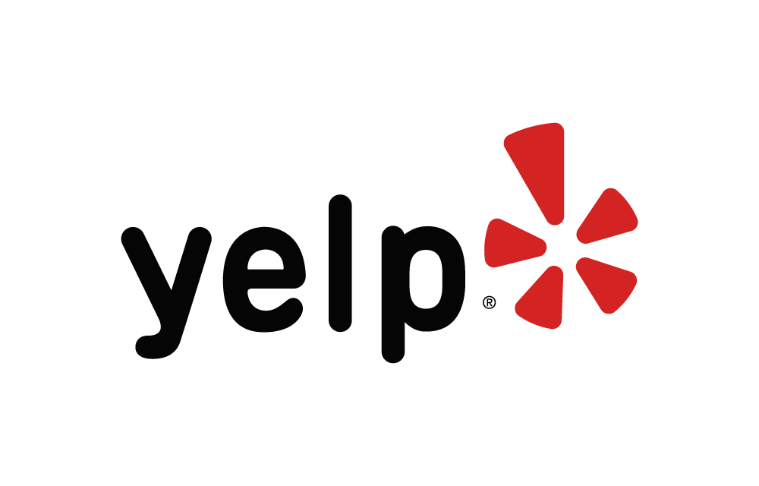
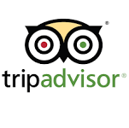
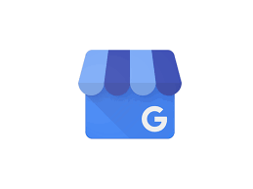
Don’t Ignore Review Sites
Notes:
The importance of online reviews
91% of people read online reviews
People tend to trust online reviews as much as they trust recommendations from friends and family
Customers are likely to spend 31% more on a business with excellent reviews
Reviews can boost your search ranking and improve conversions
Some studies suggest that nearly 70% of consumers will leave a review when respectfully prompted to do so – others put this number closer to 90%.
What do customers look for when evaluating reviews?
Star rating: Most people want to see a minimum of 3 stars, but some people will only buy from businesses with 5-stars
Quantity: Most customers want to see that you’ve gotten at least 4-6 reviews
Quality: Customers value reviews where the reviewer has put some effort in
Recency: Customers prefer reviews that were published in the past 6 months
How to get and respond to reviews
Google yourself (your business name + reviews) to see what reviews you already have – are they positive?
Which sites are most in need of more positive reviews?
Link to the review sites on your website and post information, encouraging people to offer their feedback.
Make it as easy as possible for customers to review you. When they can click a link to get to the place where they can submit a review, they’re more likely to take the time.
Print out a card or create an email with specific info on how to post a review, with links to one or all of the places where they can review you.
People are mostly likely to review you after their first encounter, so encourage your staff to ask first time customers if they use Yelp (and other social media), mention that you have a presence there, and ask them to review you.
Or, a few days after a purchase, contact the customer to ask if they’d be willing to review you. Ask customers for their feedback. Tell them you want their honest opinion.
Only seek authentic reviews – don’t ask family members to make up reviews.
You can thank people for reviewing you, but don’t give away free products to people who submit reviews.
Respond to all reviews, positive or negative, as soon as possible.
Stay open to feedback, however unpleasant or even unwarranted you think it may be. Show that you care and that you’re listening.
If you get a negative review, you may want to respond privately first and try to work out any issues that the customer experienced. Give them your phone number and ask them to call you.
Offer to make it good for them – a new meal, a gift certificate, at the very least, an apology.
If you’re able to resolve their issue, you can ask if they’d be willing to update their review.
Regardless of how your private discussion turns out, you should also respond to a bad review publicly, apologizing for the problem and showing how you tried to address it.
Most customers will take a negative review with a grain of salt if they see that the business is responsive.

Slide 26



Match Your Tools to Your Goals & Audiences
Notes:
Farmers and food businesses need to use a mix of tactics to compete in a maturing market.
Start with your goals and your audiences.
What are the key messages you want to convey about your brand, products, and services?
You should consistently and repeatedly try to get your messages out to each of your target audiences using a mix of channels that are most likely to reach them.
The fundamentals--a great product, a strong brand, and wonderful customer service—should be the foundation of your marketing strategy. Social media is the icing on the cake.
Create content that can be used on more than one channel: website/blog, social media, text messages, emails, and traditional ads and PR.
Use as much video, photos, and images as you can.
Websites are important because you control them. You can store all your content on your site and link to it from other channels.
Search Engine Optimization helps people find your business, products, and services.
Text messages are a great way to reach customers for direct marketing.
Email marketing is still one of the best ways to reach people.
Social media can be great at building customer loyalty, but is harder to use to increase sales.
Many businesses use social media because everybody else is using it, not because it’s effective.
Social media posts don’t directly increase your search ranking, but it helps create links and traffic to your site.
Most social media users are active on more than one site.
You don’t have to be on every social media channel, but it’s useful to be on more than one.

Slide 27




Social Media Usage
Channel | % Who Use | How Often | Usage by Age Grp. | Usage by Sex | Usage by Coll. grads | Usage by Hi $
 | 68 | 76% Daily | All (including 36% of 65+) | Equal | 77% | 76%
 | 28 | 51% Daily | All (including 59% of 18-29) | More W than M | 32% | 30%
 | 26 | 25% Daily | All | + More W than M | 33% | 34%
 | 25 | 18% Daily | All | More M than W | 49% | 45%
 | 21 | 42% Daily | All (esp. 18-29) | Equal | 28% | 30%
Notes:
Info in the chart refers to US Adults aged 18 and over
% Who Use: percentage of US adults who report using this channel
How Often: percentage of US adults who report using this channel daily
Usage by Age Group: Generalizations based on reported usage by each age group
Usage by Sex: Generalizations based on reported usage by each sex
Usage by College Grads: Percentage of usage reported by college graduates
Usage by Hi $: Percentage of usage reported by those earning $75,000+ annually
General facts about social media usage
African American adults spend more time on social media than any other ethnic group.
Social media is much more heavily used by people under 50 years of age than people who are 50 and older.
Generation X (ages 35-49) spends the most time (almost 7 hours/week) on social media vs. Millennials, who spend just over 6 hours per week.
Women use Pinterest and Instagram more than men do; men use LinkedIn a little more than women; and men and women use Twitter equally.
Data from Pew Social Media Update 2016:
Facebook – 79% of US Internet Users over 18
Still used the most by younger people (under 50) than over 50.
Older adults are rapidly adopting it
More women than men (83% of women, 75% of men)
More lower income (84% of Americans earning less than $30k/year use Facebook, compared to 77% of $75k+)
Instagram – 24% of US Internet Users over 18
Although older users are increasing, Instagram users skew young:
59% of 18-29 years olds, 33% of 30-49, 18% of 50-64, and only 8% of 65+
More women than men (38% of women, 26% of men)
39% of Urban residents use it, compared to 31% of rural residents.
Higher percent of lower income people use it than upper income (38% of Americans earning less than $30k/year use it, compared to 31% of $75k+), but this could be because so many users are young.
Pinterest – 31% of US Internet Users over 18
Skews female (45% of women use it, compared to 17% of men)
Skews a little young, but fairly popular until age 65+
Income level of users are fairly even.
Skews Suburban (34% of Suburban residents use it, compared to 30% of urban and 25% of rural residents.)
Skews college educated
LinkedIn – 29% of US Internet Users over 18
Skews slightly male (28% of men use it, compared to 23% of women)
Used by all ages
Heavily skews college educated (49%) vs High school or less (9%)
Skews upper income (45% of $75k+ use it, compared to 21% of Americans earning less than $30k)
Skews Urban and Suburban over rural
Twitter – 24% of US Internet Users over 18
Skews young. (Although not as youth-dominated as Instagram, 36% of 18-29 years olds use Twitter, compared to 22% of 30-49, 18% of 50-64, and only 6% of 65+ use Twitter)
Men and women use about evenly
Skews Urban (39% of Urban residents use it, compared to 31% of rural residents.)
Skews college educated (29%) vs High school or less (20%)
Skews upper income (30% of $75k+ use it, compared to 23% of Americans earning less than $30k)
Sources
http://www.pewinternet.org/2016/11/11/social-media-update-2016/
http://www.pewinternet.org/fact-sheet/social-media/ (January 12, 2017)
http://www.nielsen.com/us/en/insights/reports/2017/2016-nielsen-social-media-report.html
https://www.omnicoreagency.com/pinterest-statistics/

